Slide 1
Chapter4 Discrete-time Systems
1
Classification of Discrete Systems
2
Impulse and Step Response
3
LTI Discrete-time Systems
4
Frequency-Domain of LTI DTS
5
Phase and Group Delay
Notes:
1

Slide 2
4.7 Classification of LTI Discrete-time system
Based on impulse response length
If h[n] is finite length, we call it finite impulse response(FIR) system, otherwise, we call it infinite impulse response(IIR) system.
Based on the output calculation process
If the output can be calculated just by present and past input the system is called nonrecursive system, otherwise is called recursive system.
MOOC

Slide 3
4.8 Frequency-Domain of LTI DTS
Most discrete-time signals encountered in practice can be represented as a linear combination of sinusoidal discrete-time signals of different angular frequencies；
An important property of an LTI system is that for certain types of input signals, called eigenfunctions, the output signal is the input signal multiplied by a complex constant.
We consider one such eigenfunctions as complex exponential input signal.

Slide 4
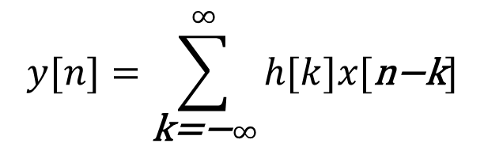
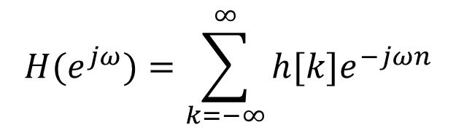
4.8.1 Frequency Response
$$y[n]=\sum_{\text{k}\text{=−}∞}^{∞}{h[k]x[\text{n}\text{−}\text{k}]}$$
According to
if we set
$$x[n]=e^{jωn}\begin{matrix}, & −∞<n<∞\end{matrix}$$
The output of an LTI system is
$$H(e^{jω})=\sum_{k=−∞}^{∞}{h[k]e^{−jωn}}$$
Where
MOOC

Slide 5
4.8.1 Frequency Response
Obviously , for a complex exponential input signal e^{jωn}, the output of an LTI discrete-time system is also the same signal multiplied by a complex constant H(e^{jω}).
Here, e^{jωn} is called an eigen function of the LTI discrete-time system.
H(e^{jω}) is called the frequency response of the LTI discrete-time system, it provides a frequency-domain description of the system and is precisely the DTFT of the impulse response h[n] of the system.

Slide 6
4.8.1 Frequency Response
H(e^{jω}) can completely characterizes the LTI discrete-time system in the frequency domain.
Just like any other DTFT, H(e^{jω}) is usually also a complex function of ω with a period 2π and can be expressed in terms of its real and imaginary parts or its magnitude and phase.
Where
MOOC

Slide 7
4.8.1 Frequency Response
|H(e^{jω})| is called the magnitude response
θ(ω) is called the phase response of the LTI discrete-time system.
The gain function:
Attenuation or loss function.

Slide 8
4.8.1 Frequency Response
In engineering, The gain function commonly use another definition as below:
For a discrete-time system characterized by a real impulse response h[n] (real system) should note:
1. |H(e^{jω})| and H_{re} (e^{jω}) are even functions.
2. θ(ω) and H_{im} (e^{jω}) are odd functions.

Slide 9
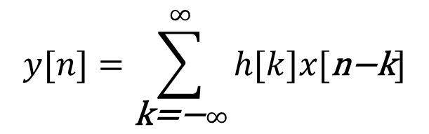
4.8.2 Frequency-Domain characterization LTI Discrete-Time systems
If we applying the convolution theorem,
we arrive at
$$y[n]=\sum_{\text{k}\text{=−}∞}^{∞}{h[k]x[\text{n}\text{−}\text{k}]}$$
Where the Y(e^{jω}) and X(e^{jω}) denote the DTFT of y[n] and x[n].
So
MOOC

Slide 10
4.8.3 Frequency Response of LTI Discrete-Time systems
Frequency Response of LTI FIR Discrete-Time Systems
Frequency Response of LTI IIR Discrete-Time Systems

Slide 11
4.8.4 Frequency Response Computation Using MATLAB
Example 4.31
The frequency response is wanted.
MOOC

Slide 12
4.8.4 Frequency Response Computation Using MATLAB
Solution:

Slide 13
4.8.4 Frequency Response Computation Using MATLAB
freqz(h,1,w)
Program 4_3.m
Magnitude responses
Phase responses
h1 = ones(1,5) / 5; h2 = ones(1,14)/14;
此跳变不能通过unwrap去掉！

Slide 14
4.8.5 Steady-state and transient Response
Determine the steady-state output y[n] of a real coefficient LTI discrete-time system with a frequency response H(e^{jω}) for an input:
x[n] = Acos(ω₀n+φ), -∞<n<∞
1）Eexpress the input x[n] as x[n] = g[n] + g*[n]
Where, g[n] = 0.5Ae^{jφ}e^{jω0n}
the response v[n] to the input g[n] is:
v[n] = 0.5A e^{jφ} H(e^{jω0})e^{jω0n}
the output v*[n] to the input g*[n] is:
v*[n] = 0.5A e^{-jφ} H(e^{-jω0})e^{-jω0n}
2）Combining these two equations is:
Notes:
The output of the system for an input e^{jω0n} is: H(e^{jω0})e^{jω0n}

Slide 15
4.8.5 Steady-state and transient Response
y[n] =v[n]+v*[n]
=0.5Ae^{jφ}H(e^{jω0})e^{jω0n}+0.5Ae^{-jφ}H(e^{-jω0})e^{-jω0n}
=0.5A|H(e^{jω0})|{e^{jθ(ω0)}e^{jφ}e^{jω0n}+e^{-jθ(ω0)}e^{-jφ}e^{-jω0n}}
=A|H(e^{jω0})|cos(ω₀n+θ(ω₀)+φ)
Thus, the output y[n] has the same sinusoidal waveform as the input with two differences:
(1) The amplitude is multiplied by |H(e^{jω0})|, the value of the magnitude function at ω=ω₀
(2) The output has a phase lag relative to the input by an amount θ(ω₀), the value of the phase function at ω=ω₀

Slide 16
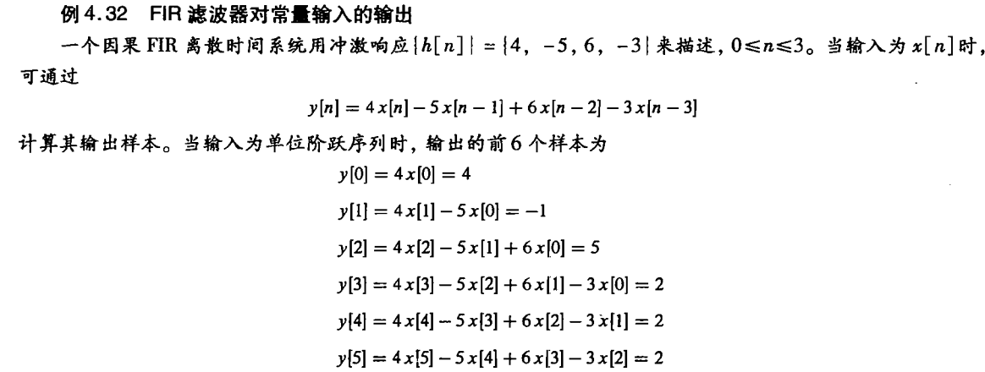
4.8.5 Steady-state and transient Response
For x[n] = A, the steady-state output is：y[n] = A|H(e^{j0})|

Slide 17
4.8.6 Response to a Causal Exponential Sequence
While the input of the LTI system is a causal exponential sequence:

Slide 18
4.8.6 Response to a Causal Exponential Sequence
The steady-state response:
The transient response:

Slide 19
4.8.7 Concept of Filtering
One application of an LTI discrete-time system is to pass certain frequency components in an input sequence without any distortion (if possible) and to block other frequency components.
Such systems are called digital filters and are one of the main subjects of discussion in this course.
MOOC

Slide 20
4.8.7 Concept of Filtering
The key to the filtering process is:
Expresses an arbitrary input as a linear weighted sum of an infinite number of exponential sequences, or equivalently, as a linear weighted sum of sinusoidal sequences
Thus, by appropriately choosing the values of the magnitude function |H(e^{jω})| of the LTI digital filter at frequencies corresponding to the frequencies of the sinusoidal components of the input, some of these components can be selectively heavily attenuated or filtered.
MOOC

Slide 21
4.8.7 Concept of Filtering
Example
Design a Filter to pass the high-frequency component(x₂[n]) but block the low-frequency component(x₁[n]) of x[n].
Solution: Assume the filter to be an FIR filter of length 3 with an impulse response :
MOOC

Slide 22
4.8.7 Concept of Filtering
The magnitude function
The phase function
In order to stop the low-frequency component from appearing at the output of the filter, the magnitude function at ω=0.1 should be equal to zero. Similarly, the magnitude function at ω =0.4 must equal to 1.
MOOC

Slide 23
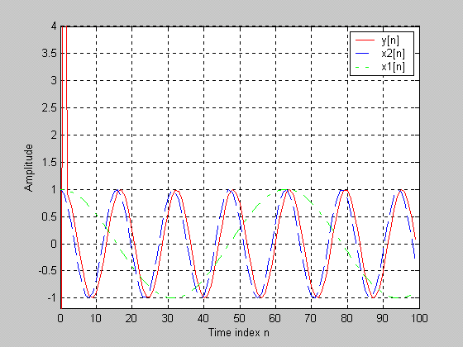
4.8.7 Concept of Filtering
% Program 4_4
b = [-6.76195 13.456335 -6.76195];
% Set initial conditions to zero values
zi = [0 0];
% Generate the two sinusoidal sequences
n = 0:99;
x1 = cos(0.1*n);
x2 = cos(0.4*n);
% Generate the filter output sequence
y = filter(b, 1, x1+x2, zi);
% Plot the input and the output sequences
plot(n,y,'r-',n,x2,'b--',n,x1,'g-.');grid
axis([0 100 -1.2 4]);
ylabel('Amplitude');
xlabel('Time index n');
legend('y[n]','x2[n]','x1[n]')

Slide 24
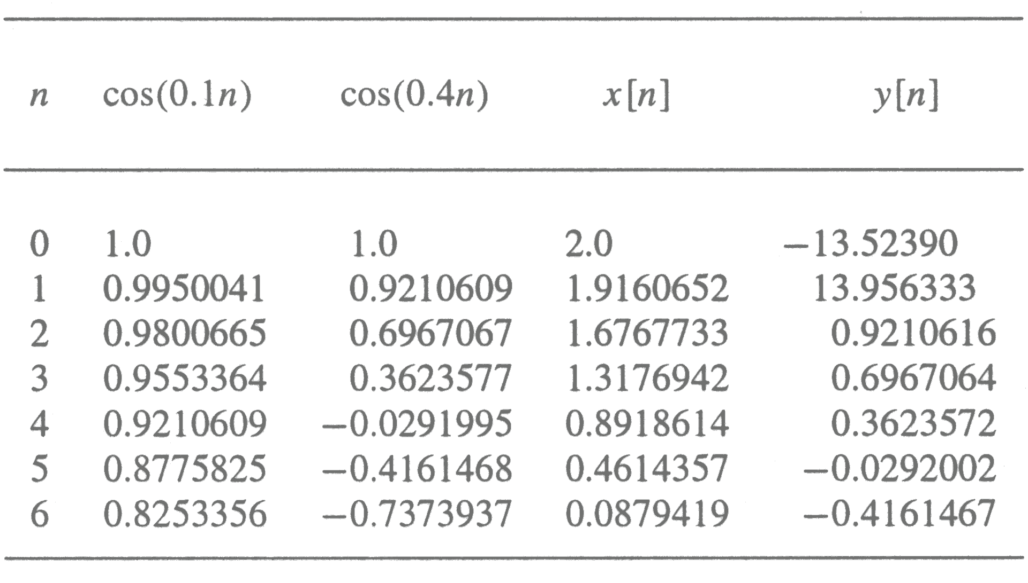
4.8.7 Concept of Filtering
The first seven samples of the output are shown below
Notes:
From this table, it can be seen that the output is delayed version of the high-frequency component of the input,
y[n] = cos(0.4(n-1)) for n ≥ 2

Slide 25
4.9 Phase and Group Delays
Recall: If the input is a sinusoidal signal of frequency ，the output is a sinusoidal signal of same frequency but lagging in phase by radians:
Definition: phase delay at ω= ω₀ given by

Slide 26
4.9 Phase and Group Delays
While input is
Where
x[n] is a narrowband signal.
In this situation, we can derivate the output signal as below:
Definition: group delay or envelope delay

Slide 27
4.9 Phase and Group Delays
phase delay
An example of group delay and phase delay
The waveform of the underlying continuous-time output shows distortion when the τ_{g} of the LTI system is not constant over the bandwidth of x[n].
A delay equalizer is usually cascaded with the LTI system.

Slide 28
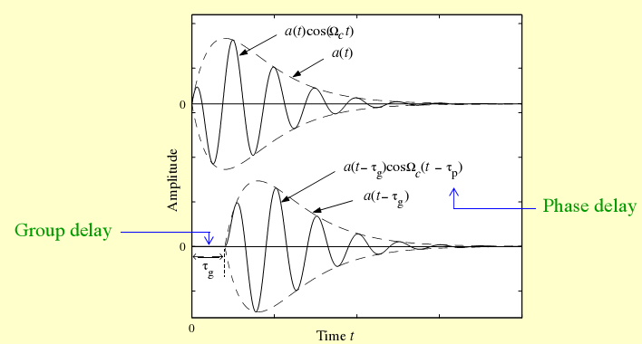
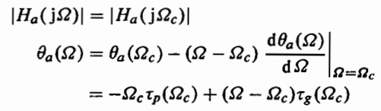
4.9 Phase and Group Delays

Slide 29
Example:
The M-point moving average filter:
The phase function is
Hence its group delay is

Slide 30


4.9.2 Phase Delay and Group Delay Computation using MATLAB
Phase delay can be computed using the function phasedelay
Group delay can be computed using the function grpdelay

Slide 31
Homework
4.1, 4.3, 4.4, 4.5, 4.8, 4.10, 4.15, 4.30(a), 4.35, 4.42, 4.51, 4.69, 4.73
M4.1, M4,5, M4,6

